Slide 1
Agenda
ECMA-262
Structure
Data Types
Operators
Loops

Slide 2

JavaScript
Official definition by ECMA: ECMAScript is an object-oriented programming language for performing computations and manipulating computational objects within a host environment.
JavaScript is a programming language that enables you to create dynamically updating content, control multimedia, animate images, and pretty much everything else.
In practice:
Imperative
(Prototype-based)Object-oriented
Functional
Asynchronous (since ES2015 (Promises), and ES2017
(async /await))

Slide 3



Editors
WebStorm Atom Visual Studio Code

Slide 4
JS output and debugging
For JavaScript values output you can use console.log or alert function.
console.log(“Hello World”);
console.log(123);
let x = 2;
alert(‘the value of x is ‘);
You can execute JS directly in console, open dev tools(F12) and go in "Console“ tab.

Slide 5
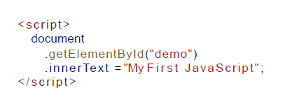
Inline Script
JavaScript programs can be inserted in any part of an HTML document with the help of the <script> element.

Slide 6
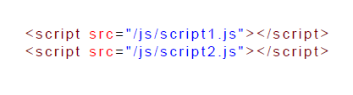
External Scripts
The other method is to import external script in an HTML document.
Separates HTML and JS : easier to maintain
Cached JavaScript files can speed up page loads.

Slide 7
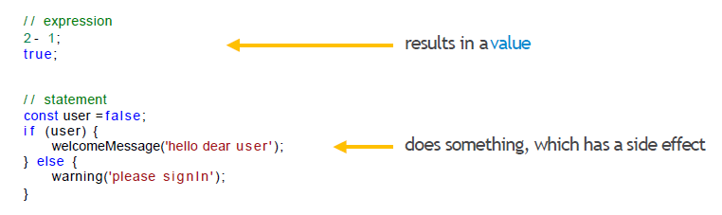
Expressions and statements
JavaScript distinguishes expressions and statements.
An expression produces a value and can be written whenever a value is expected,
For example as an argument in a function call.
A statement performs an action. Loops and if statement are examples of statements.

Slide 8
Declaration Types
var
Declares a variable, optionally initializes it with value. By default every variable gets undefined as value.
let
Declares a block- scoped, local variable, optionally initializing it to a value.
const
Declares a block-scoped, read-only named constant.

Slide 9
Operators

Slide 10
Operators
Arithmetic Operators
Assignment Operators
Logical Operators
Comparison Operators

Slide 11
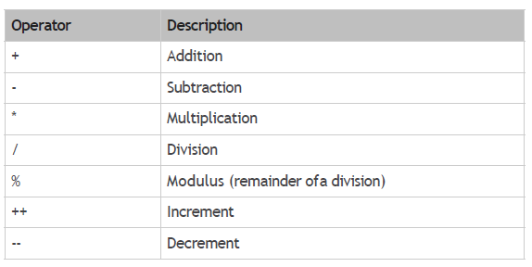
Arithmetic Operators

Slide 12
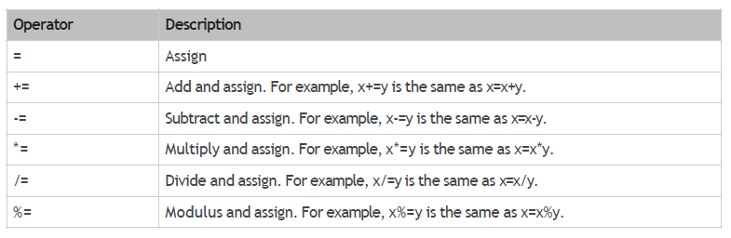
Assignment Operators

Slide 13
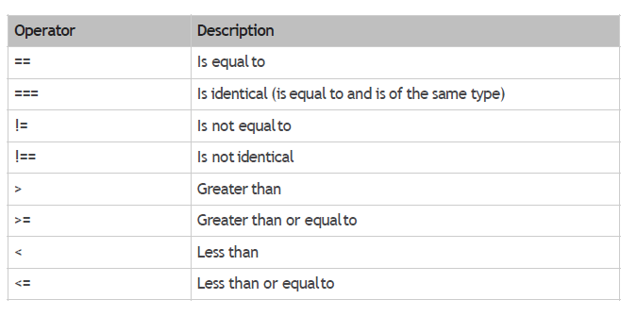
Comparison Operators

Slide 14
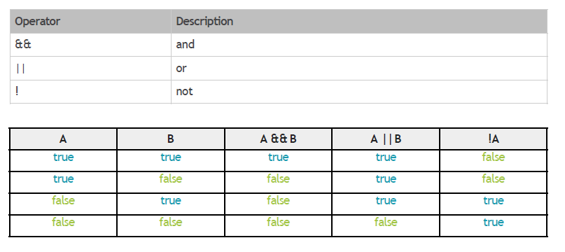
Logical Operators

Slide 15
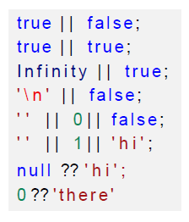
OR and NULL coalescing Operator

Slide 16
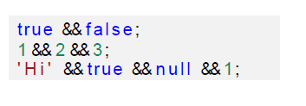
AND

Slide 17
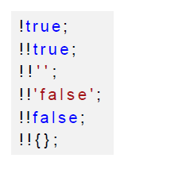
NOT

Slide 18
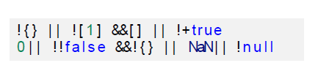
Mixed

Slide 19
Conditional Execution

Slide 20
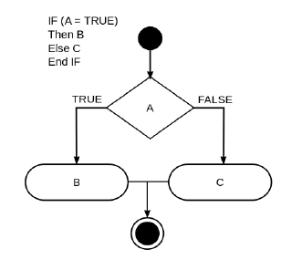
Conditional Execution
In conditional execution we choose between two different routes based on a Boolean value.
Conditional execution is written with the if keyword in JavaScript. In the simple case, we just want some code to be executed if, and only if, a certain condition holds.

Slide 21
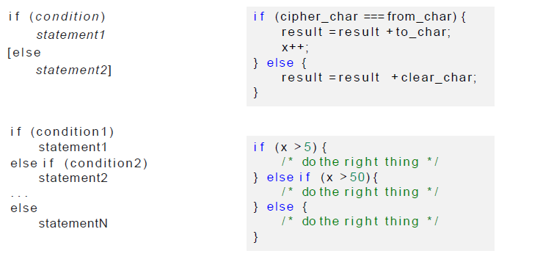
If..else

Slide 22
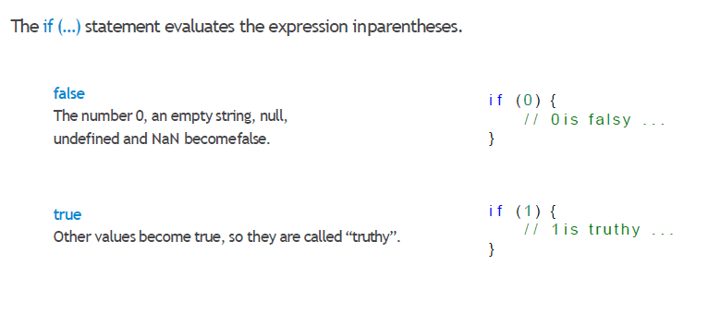
if

Slide 23
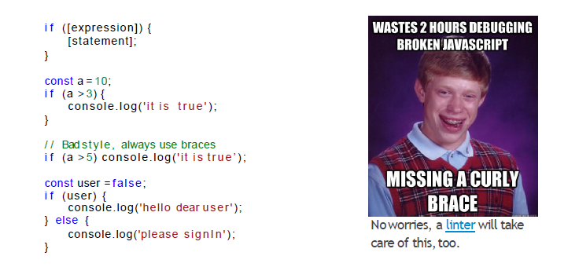
if

Slide 24
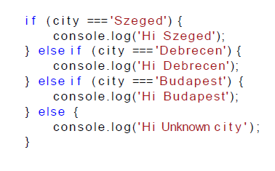
else + if
Use the else+if statements to specify a new condition if the first condition is false.

Slide 25
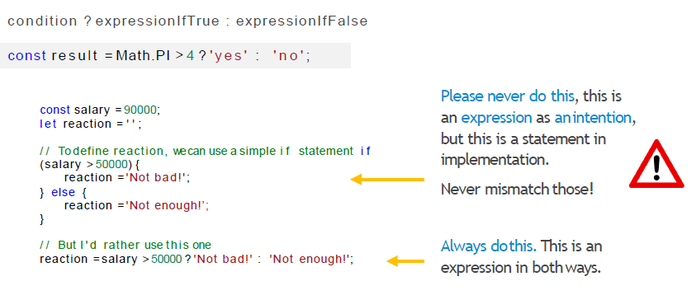
Conditional (ternary) operator

Slide 26
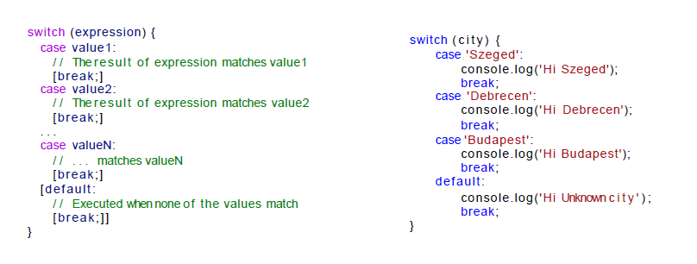
Switch

Slide 27
Loops

Slide 28
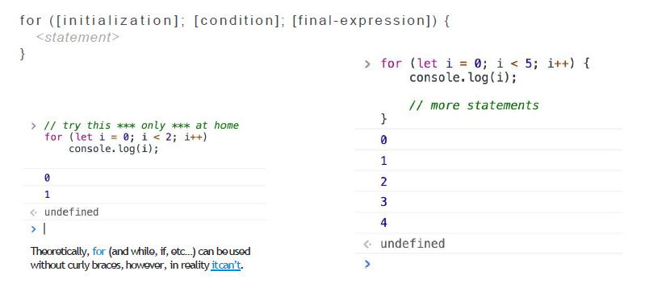
for

Slide 29
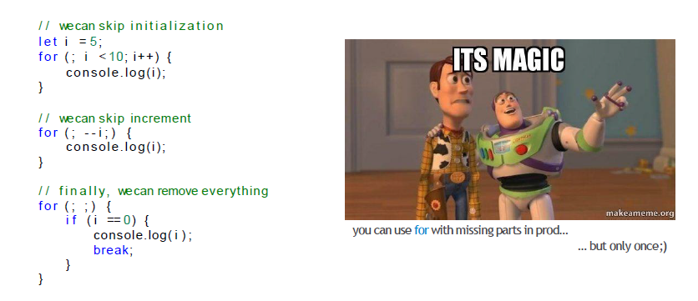
For with missing parts

Slide 30
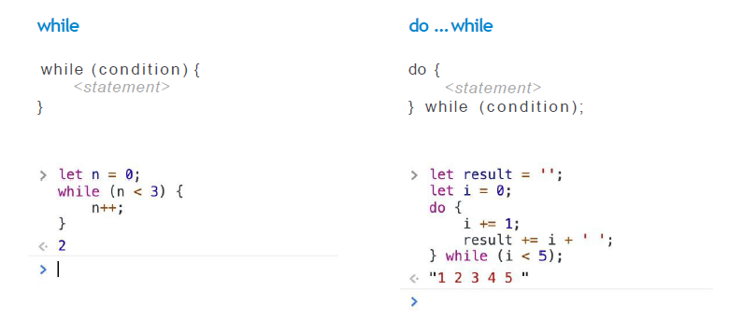
while, do … while

Slide 31
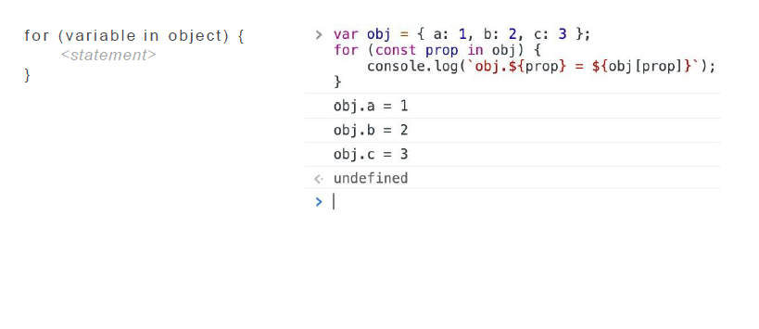
For…in

Slide 32
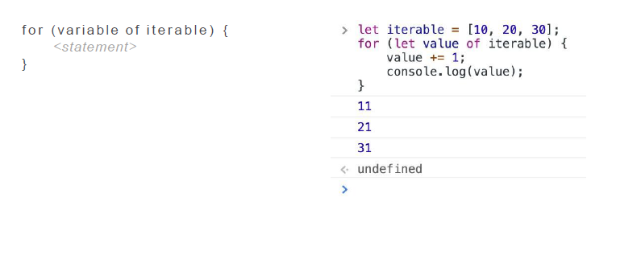
For…of

Slide 33
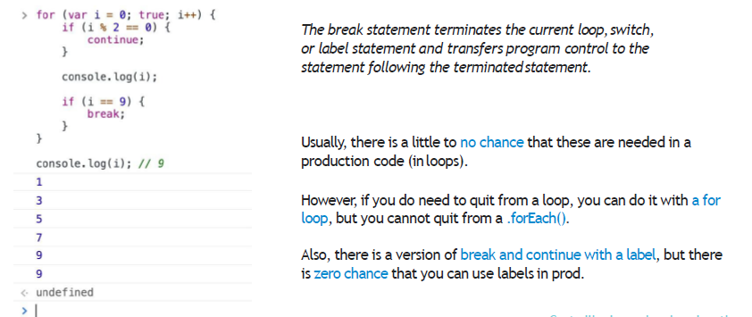
Break, continue (without a label)

